Slide 1
BACS Proj 4
Group 3
Notes:
Joe

Slide 2
Case Description
Database for a company with warehouses
Each warehouse has several bins
Parts are stored in bins
Parts that make up other parts are called assemblies
There are uniquely identified batches for each part
Batches are checked in upon arrival by a manager
Some parts may be backordered
Backorders are archived after completion
Many employees work for the company
Each employee has only one Manager
Managers don’t work under other managers
Notes:
Tyler

Slide 3
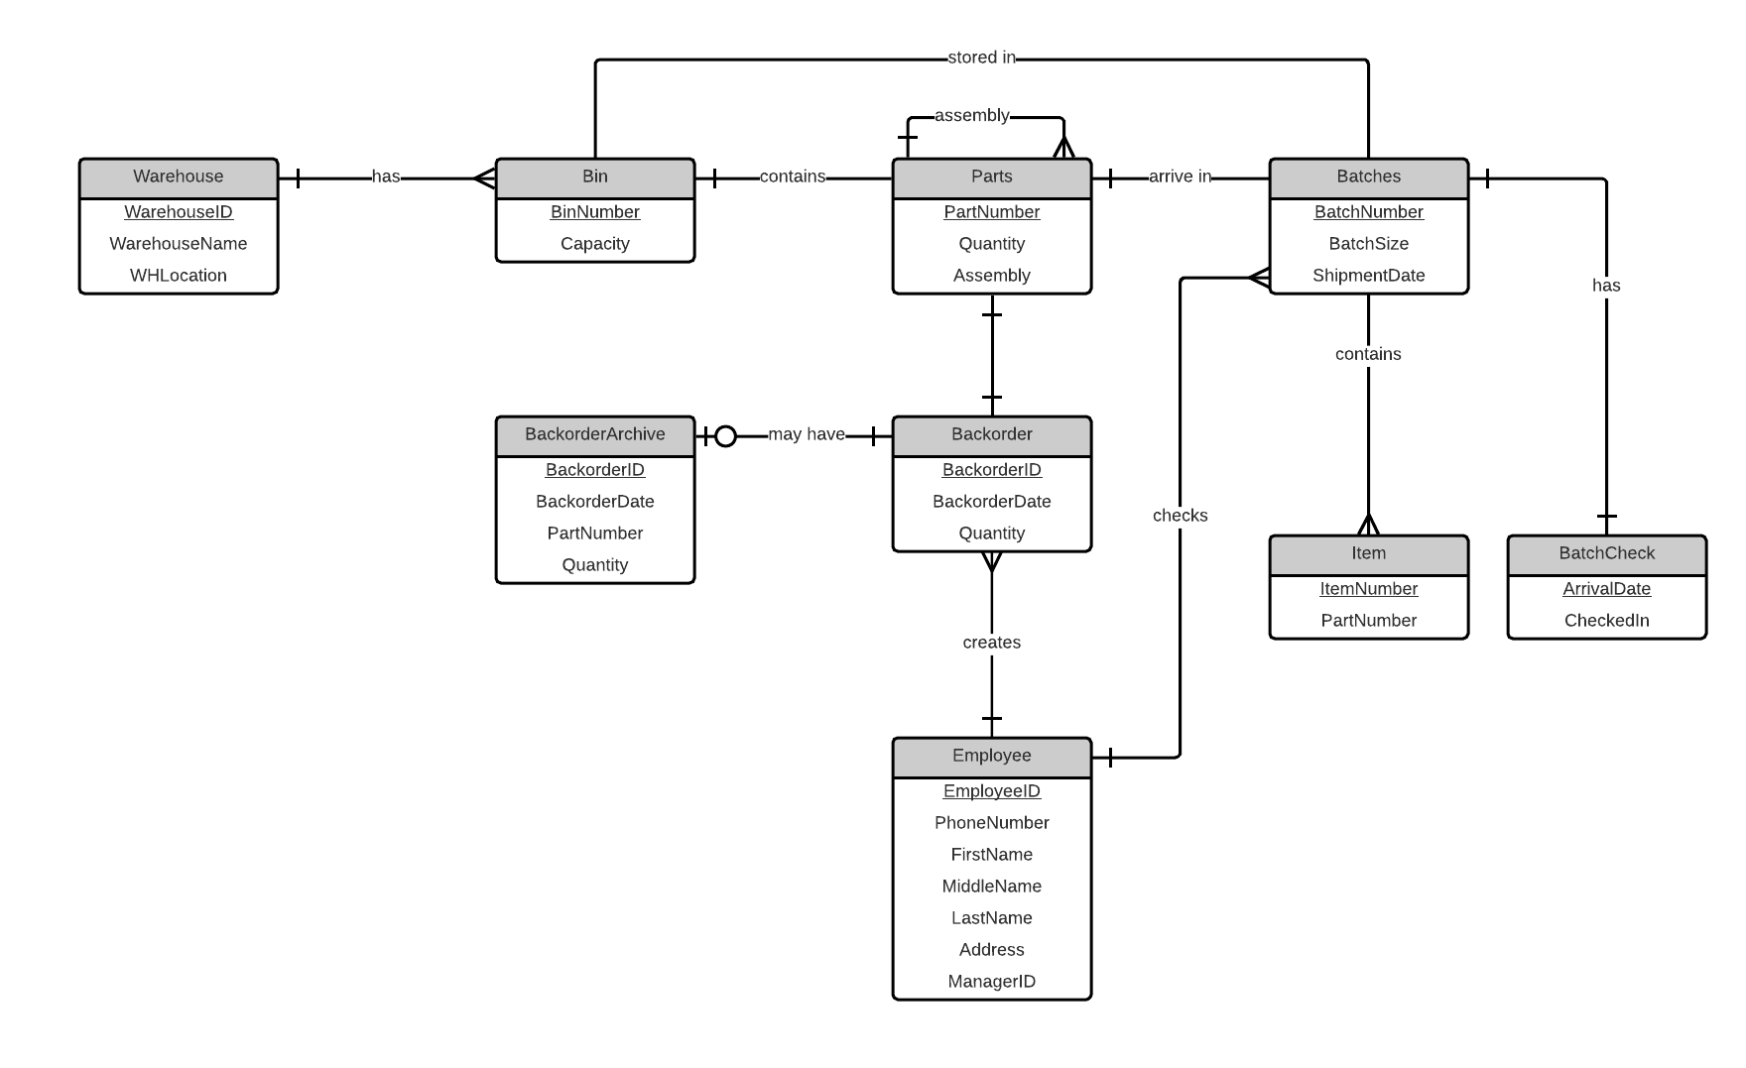
E/R Diagram
Notes:
Casey

Slide 4
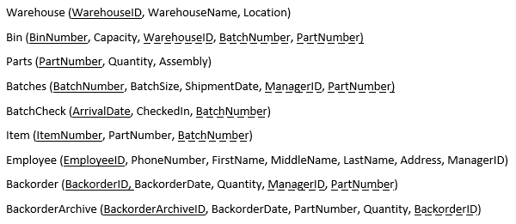
Relational Notation
Notes:
Spencer

Slide 5
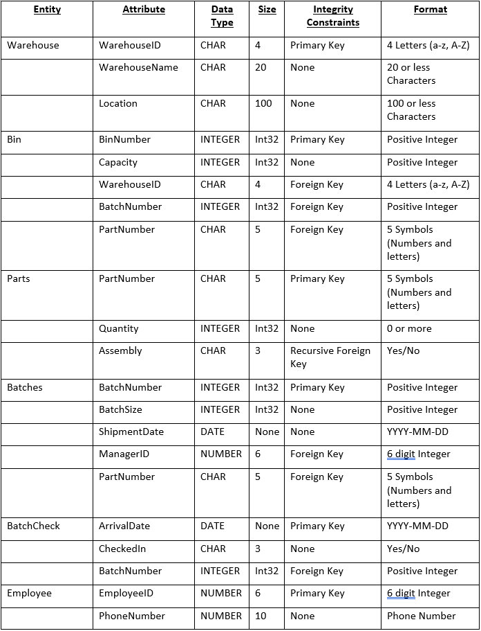
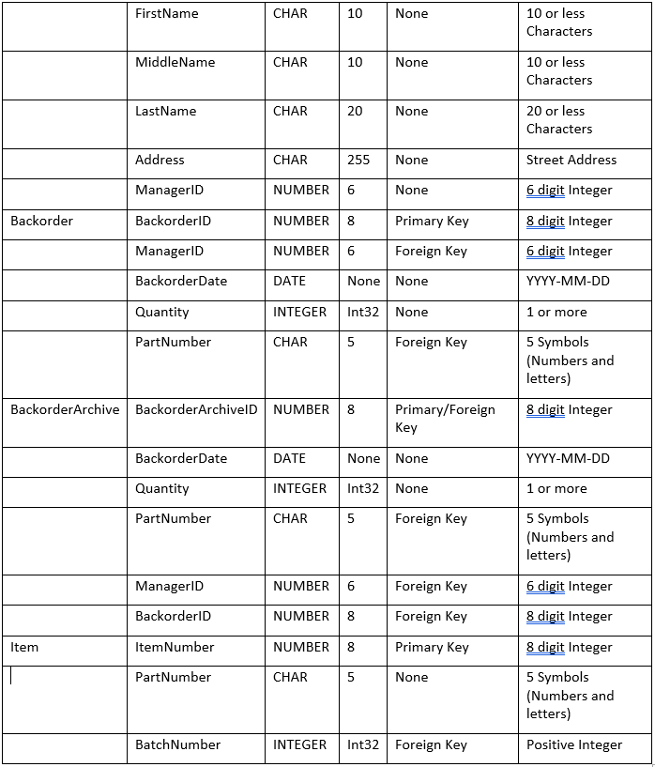
Data Dictionary
Notes:
Joe

Slide 6
Assumptions
New bins will only be added when new parts are introduced
The company has a fairly small amount of parts
Each employee only has one registered name
Each employee only has one registered address
Managers manage themselves
Each batch of parts are exclusive to only one bin
Notes:
Tyler

Slide 7
Creating Tables SQL
CREATE TABLE Warehouse (
WarehouseID CHAR(4),
WarehouseName CHAR(20),
Location CHAR(100),
PRIMARY KEY (WarehouseID)
);
CREATE TABLE Employee (
EmployeeID NUMBER(6,0),
PhoneNumber NUMBER(10,0),
FirstName CHAR(10),
MiddleName CHAR(10),
LastName CHAR(10),
Address CHAR(255),
ManagerID NUMBER(6,0),
PRIMARY KEY (EmployeeID)
);
CREATE TABLE Parts (
PartNumber CHAR(5),
Quantity INTEGER,
Assembly CHAR(3),
PRIMARY KEY (PartNumber)
);
CREATE TABLE Backorder (
BackorderID NUMBER(8,0),
BackorderDate DATE,
ManagerID NUMBER(6,0),
Quantity INTEGER,
PartNumber CHAR(5),
FOREIGN KEY (ManagerID) REFERENCES Employee,
FOREIGN KEY (PartNumber) REFERENCES Parts,
PRIMARY KEY (BackorderID)
);
CREATE TABLE BackorderArchive (
BackorderArchiveID NUMBER(8,0),
BackorderDate DATE,
PartNumber CHAR(5),
Quantity INTEGER,
BackorderID NUMBER(8,0),
FOREIGN KEY (BackorderID) REFERENCES Backorder,
PRIMARY KEY (BackorderArchiveID)
);
CREATE TABLE Batches (
BatchNumber INTEGER,
BatchSize INTEGER,
ShipmentDate DATE,
ManagerID NUMBER(6,0),
PartNumber CHAR(5),
FOREIGN KEY (PartNumber) REFERENCES Parts,
FOREIGN KEY (ManagerID) REFERENCES Employee,
PRIMARY KEY (BatchNumber)
);
CREATE TABLE BatchCheck (
ArrivalDate DATE,
CheckedIn CHAR(3),
BatchNumber INTEGER,
PRIMARY KEY (ArrivalDate),
FOREIGN KEY (BatchNumber) REFERENCES Batches
);
CREATE TABLE Item (
ItemNumber NUMBER(8,0),
PartNumber CHAR(5),
BatchNumber INTEGER,
FOREIGN KEY (BatchNumber) REFERENCES Batches,
PRIMARY KEY (ItemNumber)
);
CREATE TABLE Bin (
BinNumber INTEGER,
Capacity INTEGER,
WarehouseID CHAR(4),
BatchNumber INTEGER,
PartNumber CHAR(5),
FOREIGN KEY (PartNumber) REFERENCES Parts,
FOREIGN KEY (WarehouseID) REFERENCES Warehouse,
FOREIGN KEY (BatchNumber) REFERENCES Batches,
PRIMARY KEY (BinNumber)
);
Notes:
Casey

Slide 8
Inserting Data SQL
#Warehouse
INSERT INTO Warehouse VALUES ('AAAA', 'E-Storage', 'Boston');
INSERT INTO Warehouse VALUES ('BBBB', 'Storage-Plus', 'Seattle');
#Employee
INSERT INTO Employee VALUES ('111111', 9701112222, 'Randall', 'Bryan', 'Lawrence', '212 W10th Street', '111111');
INSERT INTO Employee VALUES ('222222', 9702223333, 'Marcus', 'Edgar', 'Cruz', '540 Pioneer Drive’', '111111');
#Parts
INSERT INTO Parts VALUES ('AA110', 30, 'No');
INSERT INTO Parts VALUES ('AB120', 60, 'No');
#Backorder
INSERT INTO Backorder VALUES (23748234, TO_DATE('11-NOV-2017','DD-MON-YYYY') ,111111, 10, 'AB120');
INSERT INTO Backorder VALUES (73982340, TO_DATE(‘09-OCT-2017’,’DD-MON-YYYY’), 444444, 20, ‘ER170’);
#BackorderArchive
INSERT INTO BackorderArchive VALUES (12319925, TO_DATE(‘24-NOV-2017’,’DD-MON-YYYY’)’, ‘AB120’, 10, 23748234);
#Batches
INSERT INTO Batches VALUES (11, 30, TO_DATE(‘12-NOV-2017’,’DD-MON-YYYY’), '111111', ‘AB120’);
INSERT INTO Batches VALUES (12, 60, TO_DATE(‘03-NOV-2017’,’DD-MON-YYYY’), '111111', ‘X88S0’);
#BatchCheck
INSERT INTO BatchCheck VALUES (TO_DATE(‘16-NOV-2017’,’DD-MON-YYYY’), 'Yes', 11);
INSERT INTO BatchCheck VALUES (TO_DATE(‘19-NOV-2017’,’DD-MON-YYYY’), 'Yes', 12);
#Item
INSERT INTO Item VALUES (11221122, 'AB120', 11);
INSERT INTO Item VALUES (22332233, 'ER170', 21);
#Bin
INSERT INTO Bin VALUES (9, 120, 'AAAA',11,’AB120’);
INSERT INTO Bin VALUES (13, 90, 'AAAA',12,’X88S0’);
Notes:
Spencer

Slide 9
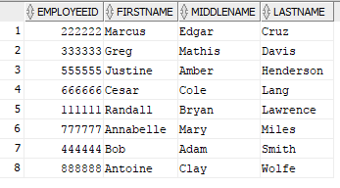
SQL Queries
Give the names and employee numbers for all workers. The names should be listed in ascending order by last, then first, then middle
SELECT EmployeeID, FirstName, MiddleName, LastName
FROM Employee
ORDER BY LastName, FirstName, MiddleName;
Notes:
Joe

Slide 10

SQL Queries
Print out all the phone numbers and employee numbers for all managers.
SELECT EmployeeID, PhoneNumber
FROM Employee
WHERE EmployeeID = Employee.ManagerID;
Notes:
Tyler

Slide 11

SQL Queries
List all parts that are assemblies. Only list each assembly 1 time.
SELECT PartNumber
FROM Parts
WHERE Parts.Assembly = 'Yes';
Notes:
Casey

Slide 12

SQL Queries
For each manager, list all current backorders done by the manager
SELECT BackorderID, ManagerID
FROM Backorder
ORDER BY ManagerID;
Notes:
Spencer

Slide 13
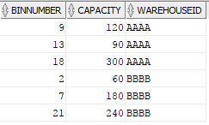
SQL Queries
For each warehouse bin, print the warehouse id, bin id, and remaining capacity of the bin
SELECT BinNumber, Capacity, WarehouseID
FROM Bin;
Notes:
Joe

Slide 14
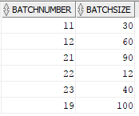
SQL Queries
Give the batch number and the number of items in each batch. Only one line for each batch should print
SELECT BatchNumber, BatchSize
FROM Batches;
Notes:
Tyler

Slide 15
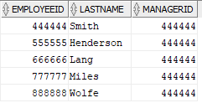
SQL Queries
Give the employee number for all workers that are managed by a manager with a last name of “Smith”.
SELECT EmployeeID, LastName, ManagerID
FROM Employee
WHERE (SELECT ManagerID
FROM Employee
WHERE LastName = 'Smith' AND EmployeeID = ManagerID) = ManagerID;
Notes:
Casey

Slide 16
Problems
Schedule conflicts (Thanksgiving Break)
Adding Dates in SQL
Forgetting to add foreign keys to appropriate tables
Notes:
Spencer

